Slide 1
BACKGROUND AND INTRODUCTION
My name is Aswa Philip Katiechi. I am a 5th year BSc. Mechatronics student and possess experience in the 3D world including experience in Blender, adobe suite, Unity and currently working on Ureal Engine.
My 3D skills include modeling, sculpting, editing, texturing, compositing and rigging in Blender, creation of cinematic videos and animated logos in adobe after effects, poster creation in photoshop.
I also have experience in game development, AR and VR in Unity and recently I have been practicing on Unreal Engine platform. I have a good understanding of C# and .NET frame work in the industry.
In addition to that am also skilled in sound design, using tools like Fl Studio and Ableton Live. I use sound in animation.
Am a practicing full stack developer with 2 years of experience in working with react, html, JavaScript, CSS, bootstrap, tailwind CSS, PHP, Python for frontend and Mongo DB and Nodejs for backend. I am a team player who is results oriented.
I also do pen and pencil art.

Slide 2
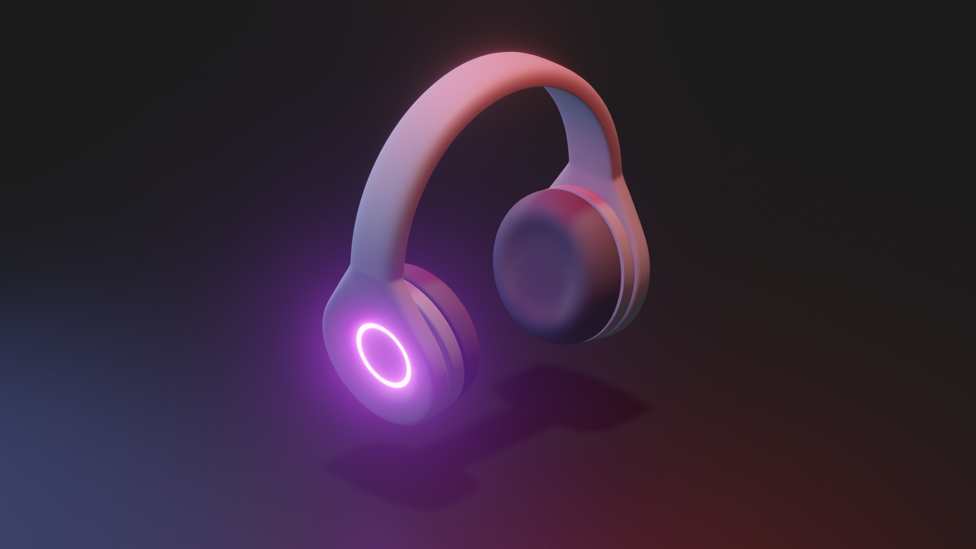
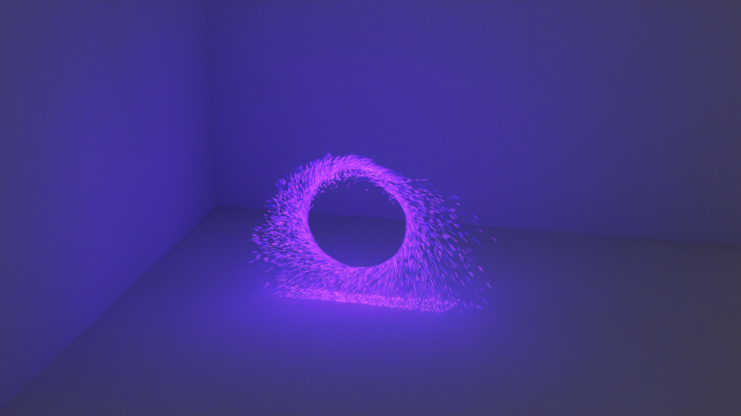
Blender 3D Modeling:

Slide 3
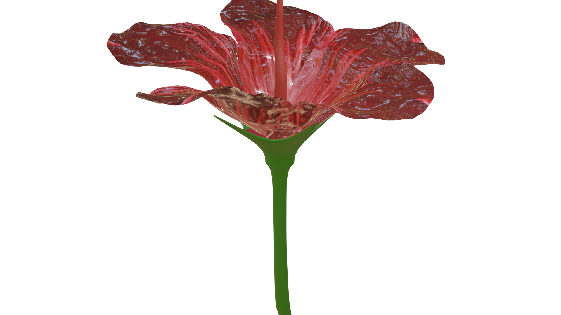
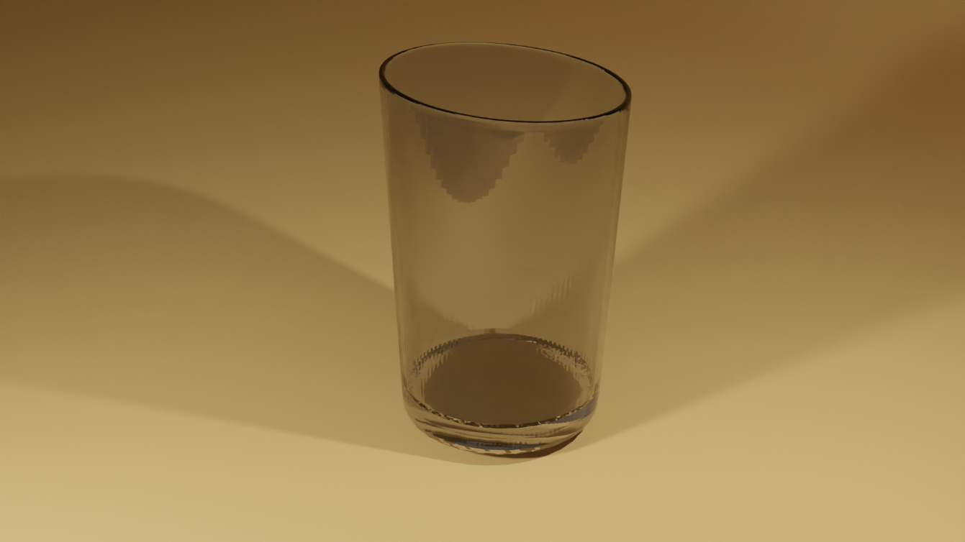
Blender 3D Modeling:

Slide 4
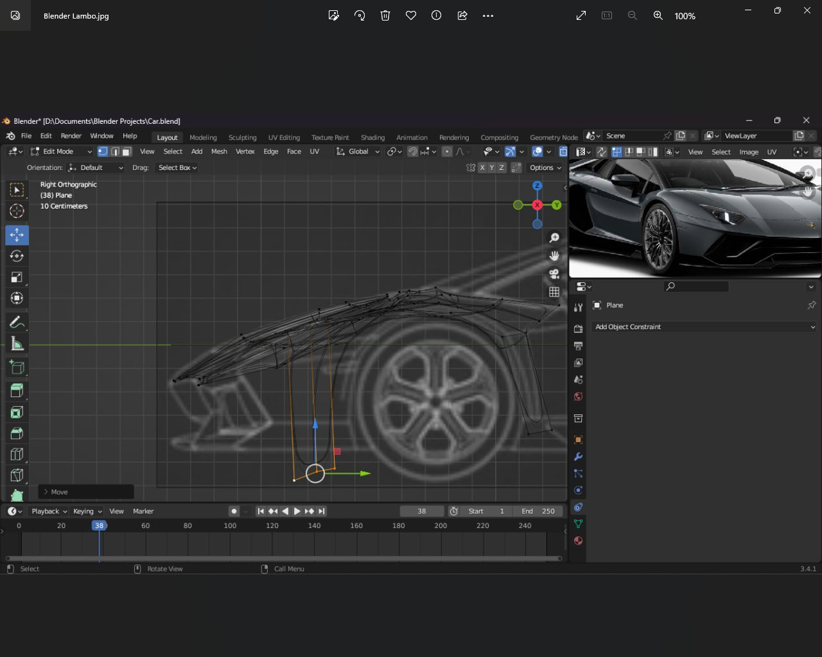
Sculpting

Slide 5
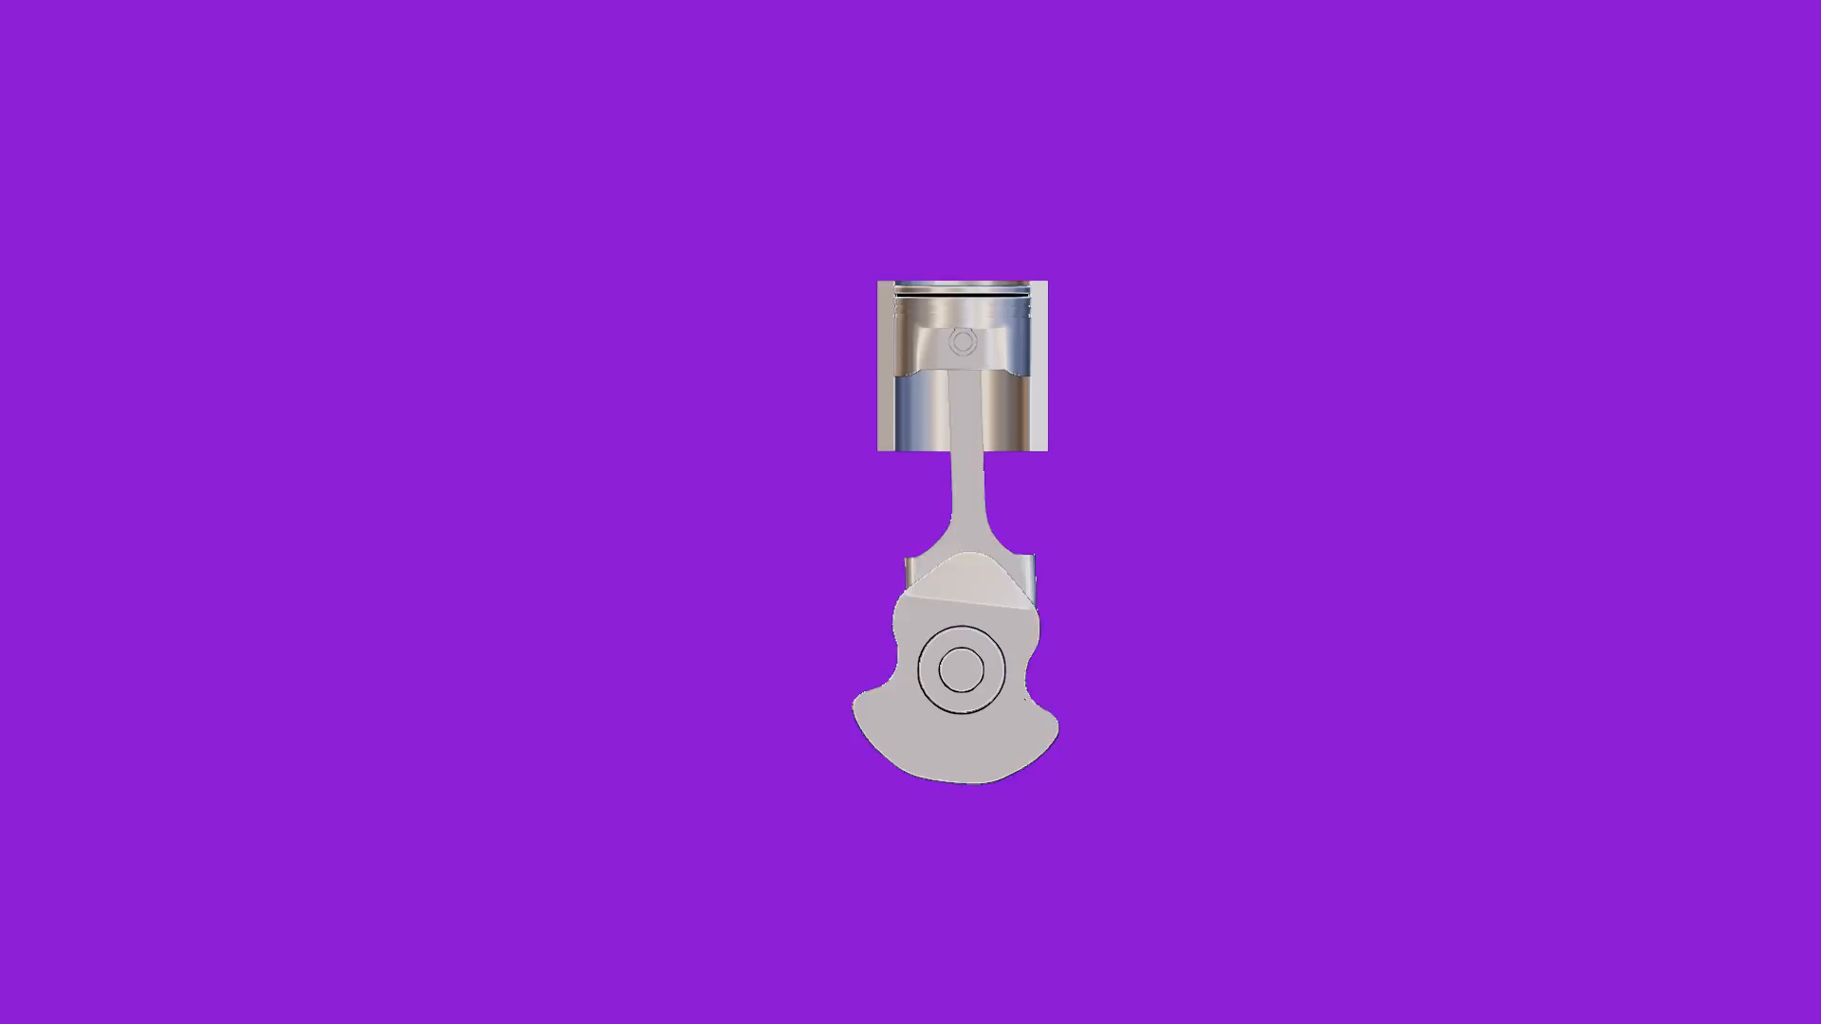
3D Rigging:
Video

Slide 6
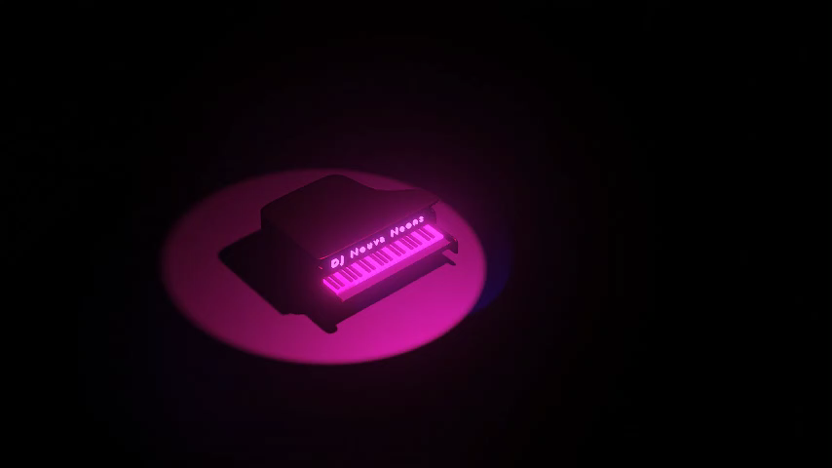
Blender 3D Animation: Piano
Video

Slide 7
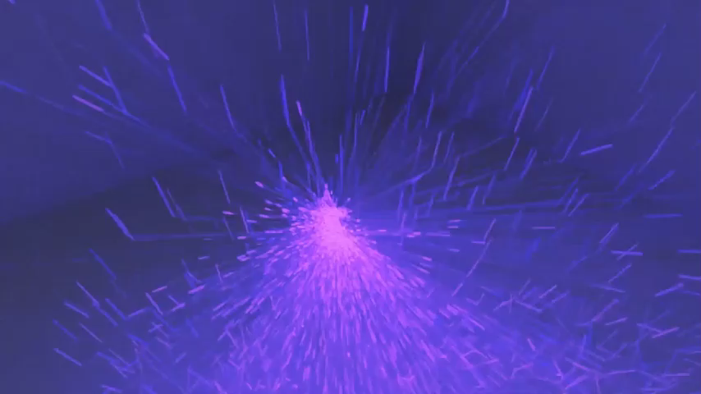
Animation in Blender
Video

Slide 8
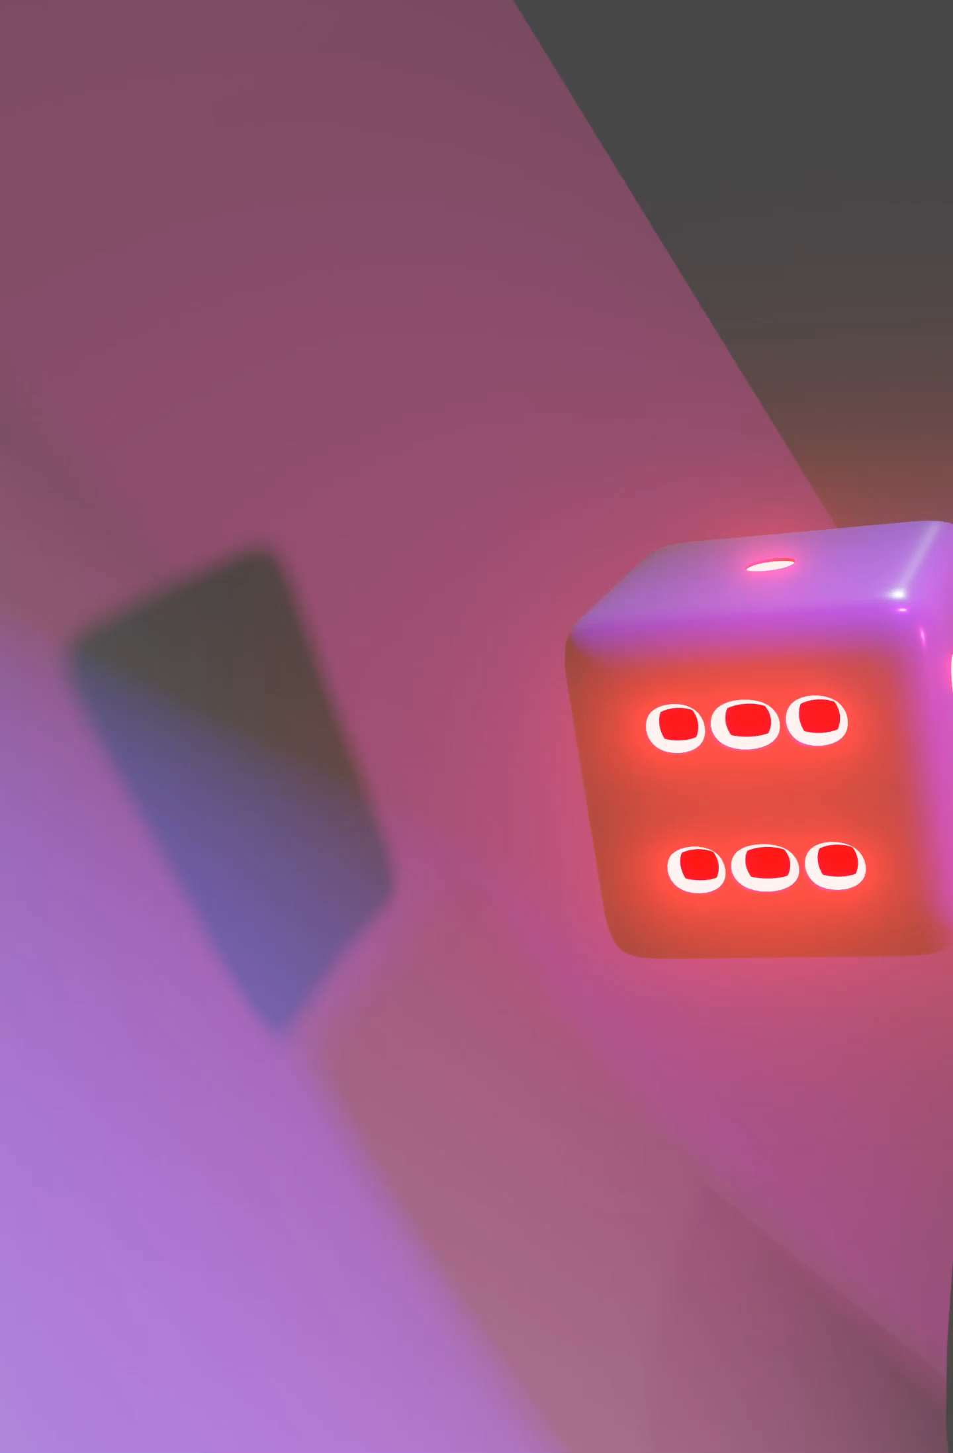
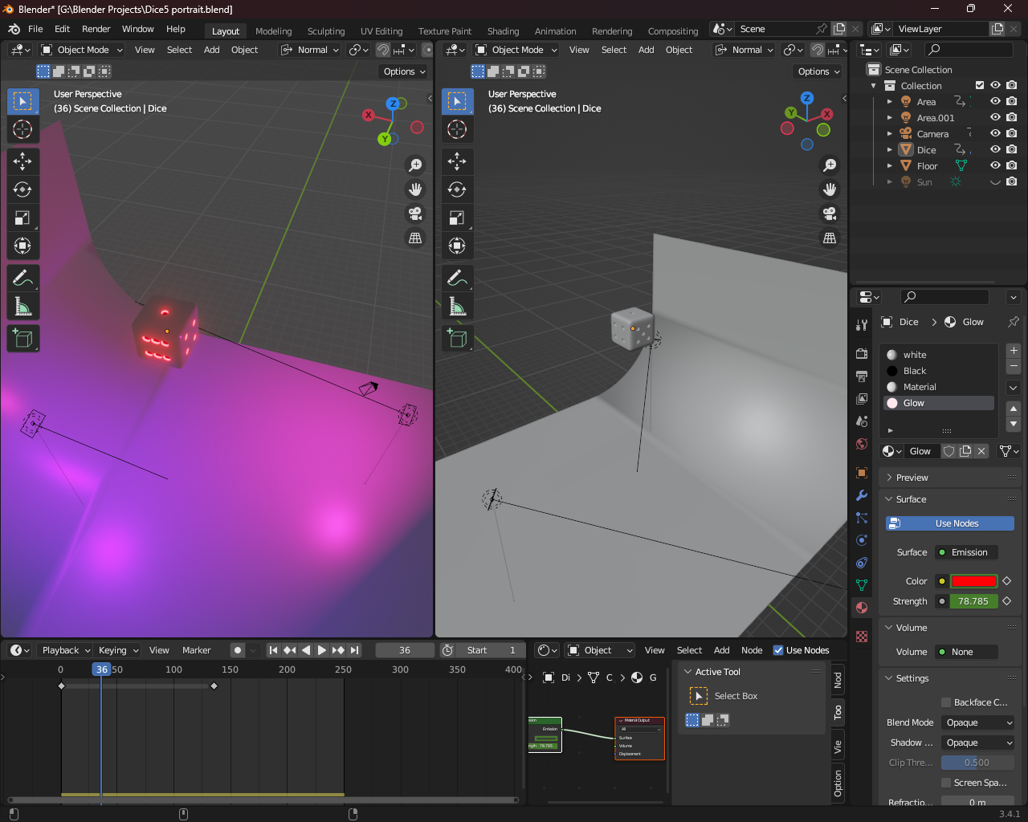
3D Modelling, Animation
Video

Slide 9
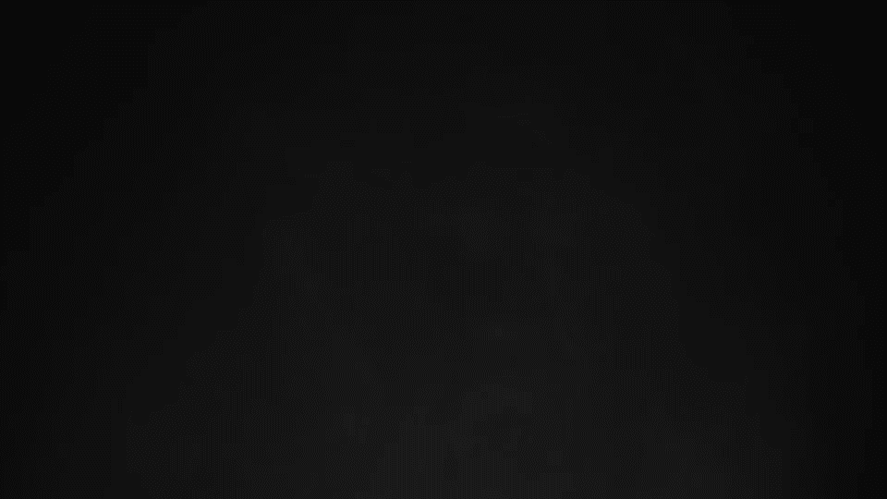
Adobe After Effects: Warner Bros Logo Animation
Video

Slide 10
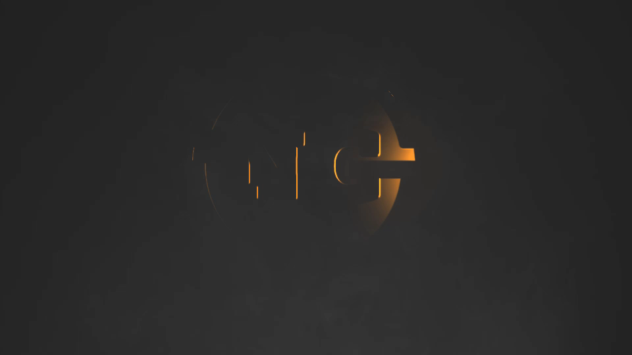
Adobe After Effect: Custom Logo Animation
Video

Slide 11




Adobe Photoshop:

Slide 12
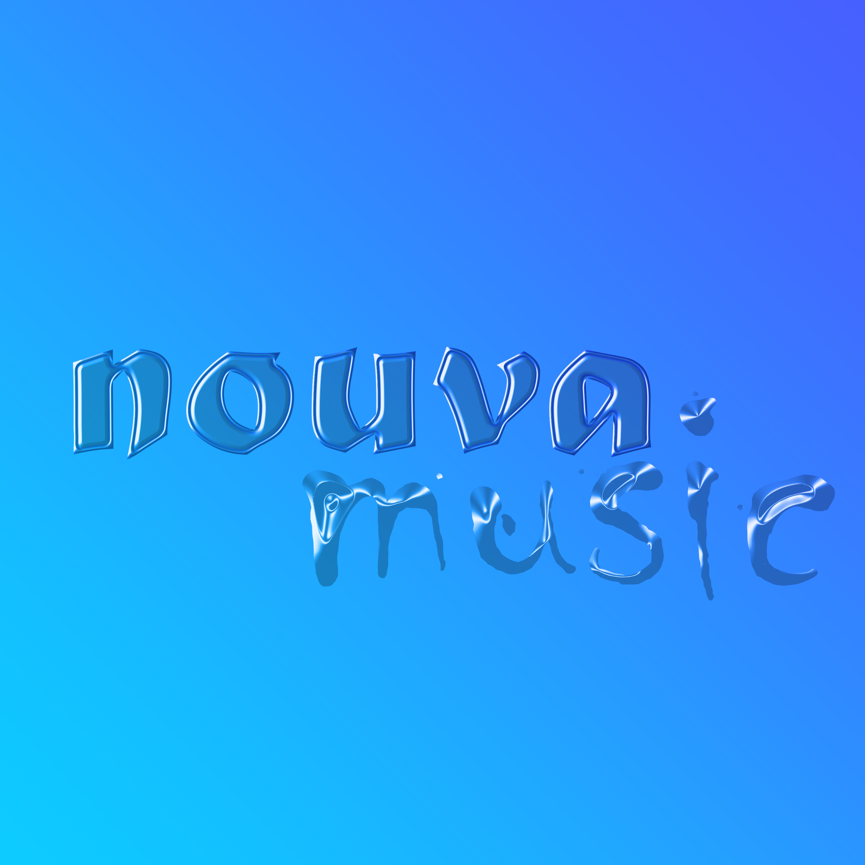
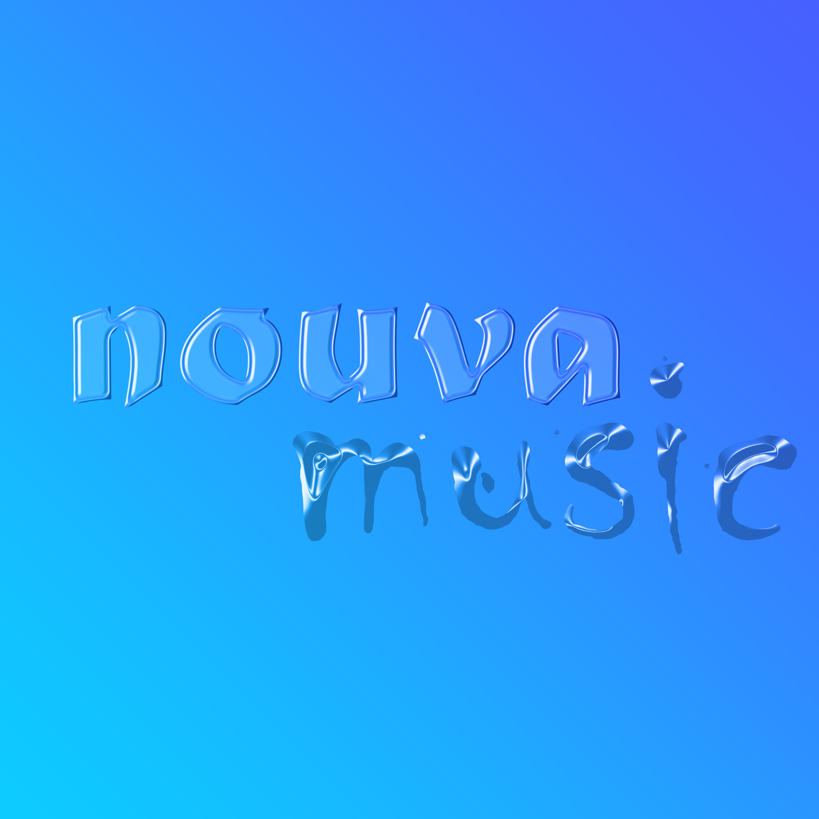


Adobe Photoshop samples:

Slide 13
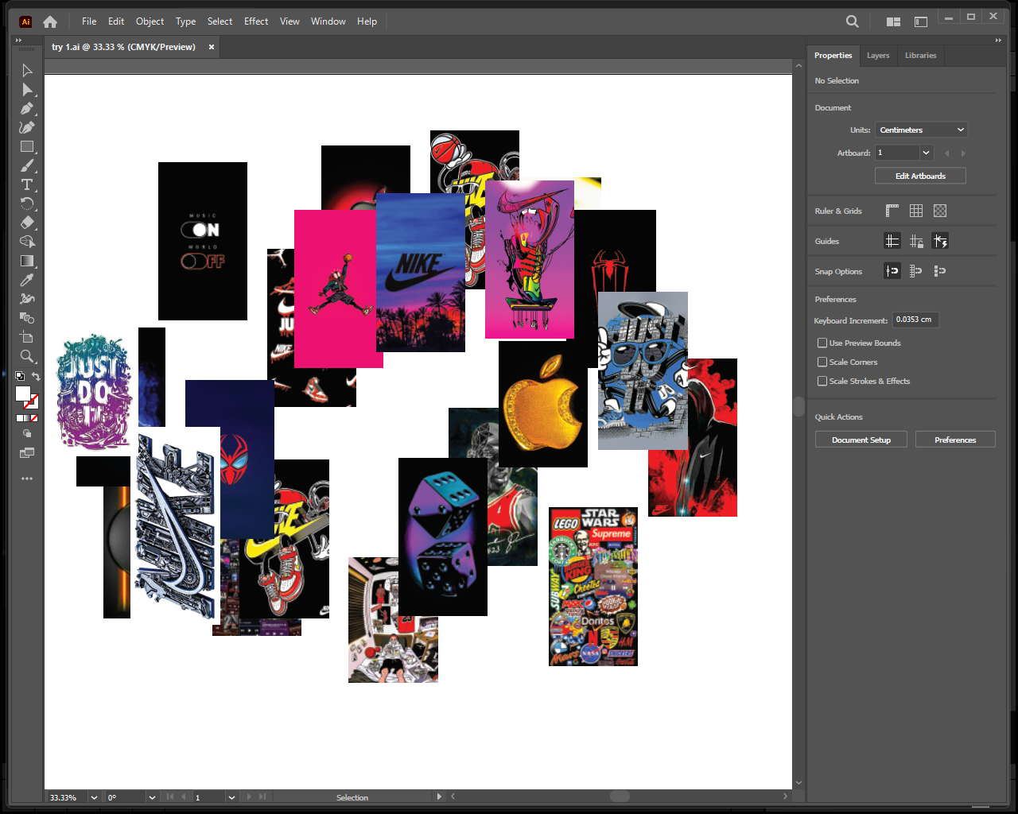
Adobe illustrator:

Slide 14
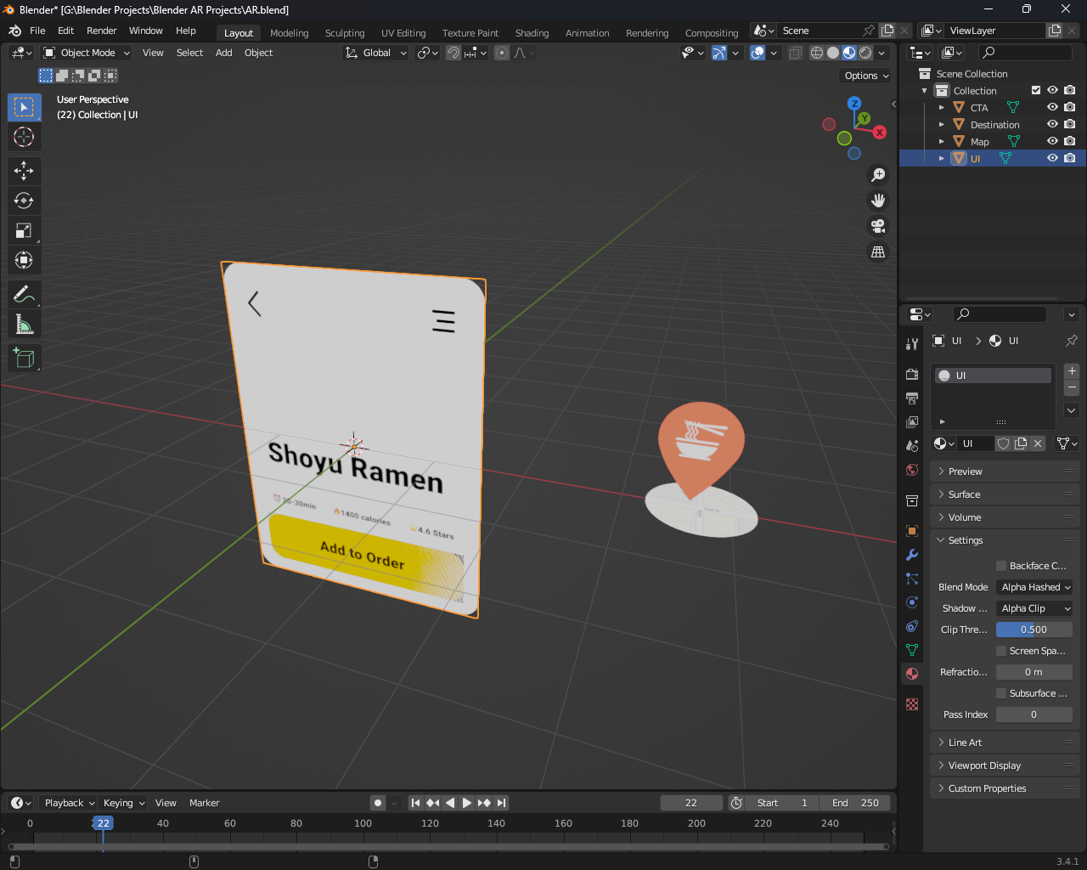
Augmented Reality in Blender:

Slide 15
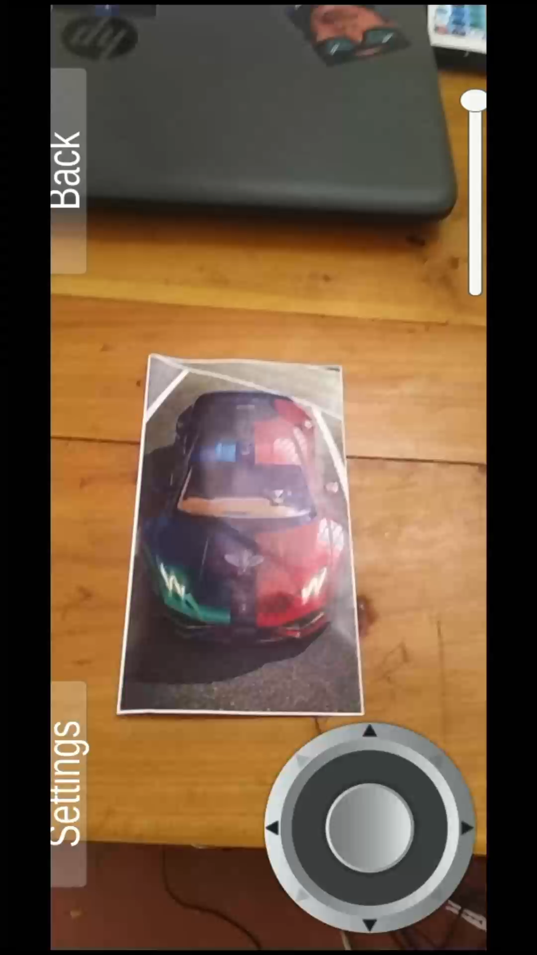
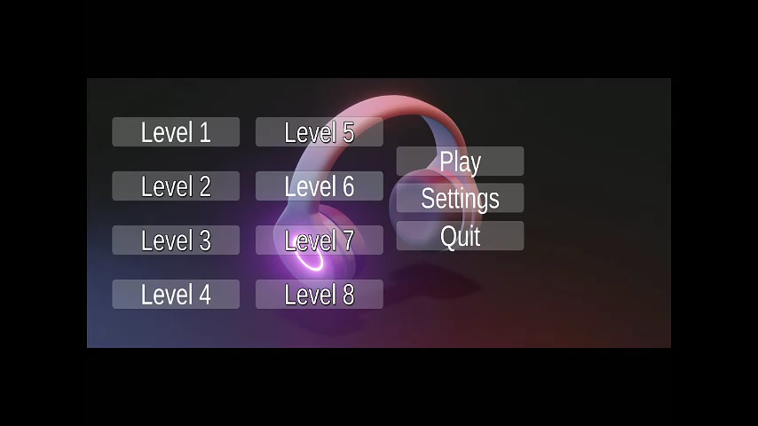
Augmented Reality
Video
Video

